Slide 1
STACKS & QUEUE

Slide 2
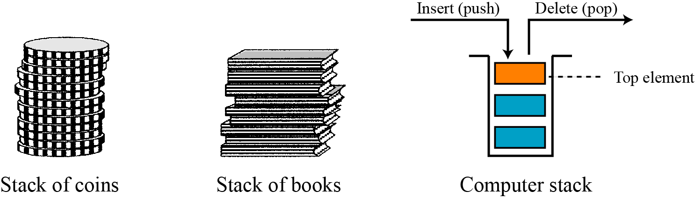
STACK
A stack is a restricted linear list in which all additions and deletions are made at one end, the top. If we insert a series of data items into a stack and then remove them, the order of the data is reversed. This reversing attribute is why stacks are known as last in, first out (LIFO) data structures.

Slide 3
Last In First Out
B
A
C
B
A
D
C
B
A
E
D
C
B
A
top
D
C
B
A
top
top
top
top
top
A

Slide 4
Stack implementation
At the ADT level, we use the stack and its four operations; at the implementation level, we need to choose a data structure to implement it. Stack ADTs can be implemented using either an array or a linked list. Figure 12.7 shows an example of a stack ADT with five items. The figure also shows how we can implement the stack.
In our array implementation, we have a record that has two fields. The first field can be used to store information about the array. The linked list implementation is similar: we have an extra node that has the name of the stack. This node also has two fields: a counter and a pointer that points to the top element.
12.‹#›
Notes:
‹#›

Slide 5
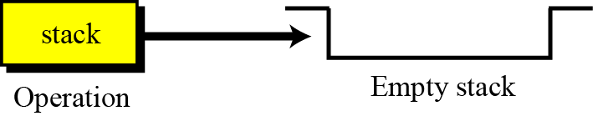
Operations on stacks
There are four basic operations, stack, push, pop and empty, that we define in this chapter.
The stack operation
The stack operation creates an empty stack. The following shows the format.

Slide 6
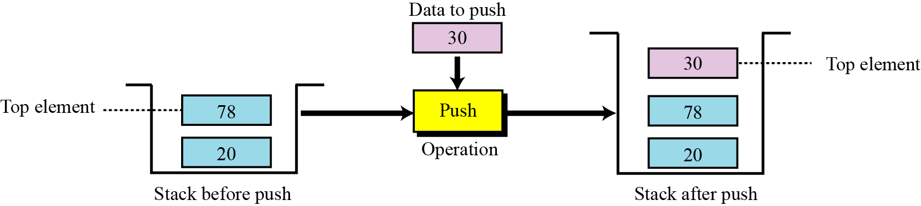
The push operation
The push operation inserts an item at the top of the stack. The following shows the format.

Slide 7
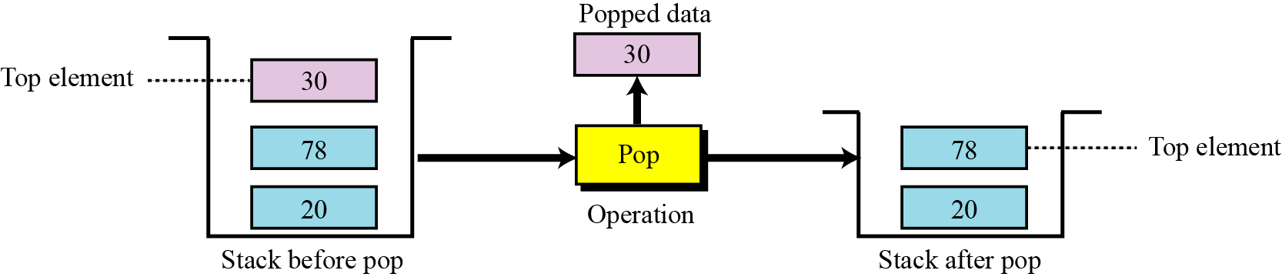
The pop operation
The pop operation deletes the item at the top of the stack. The following shows the format.

Slide 8
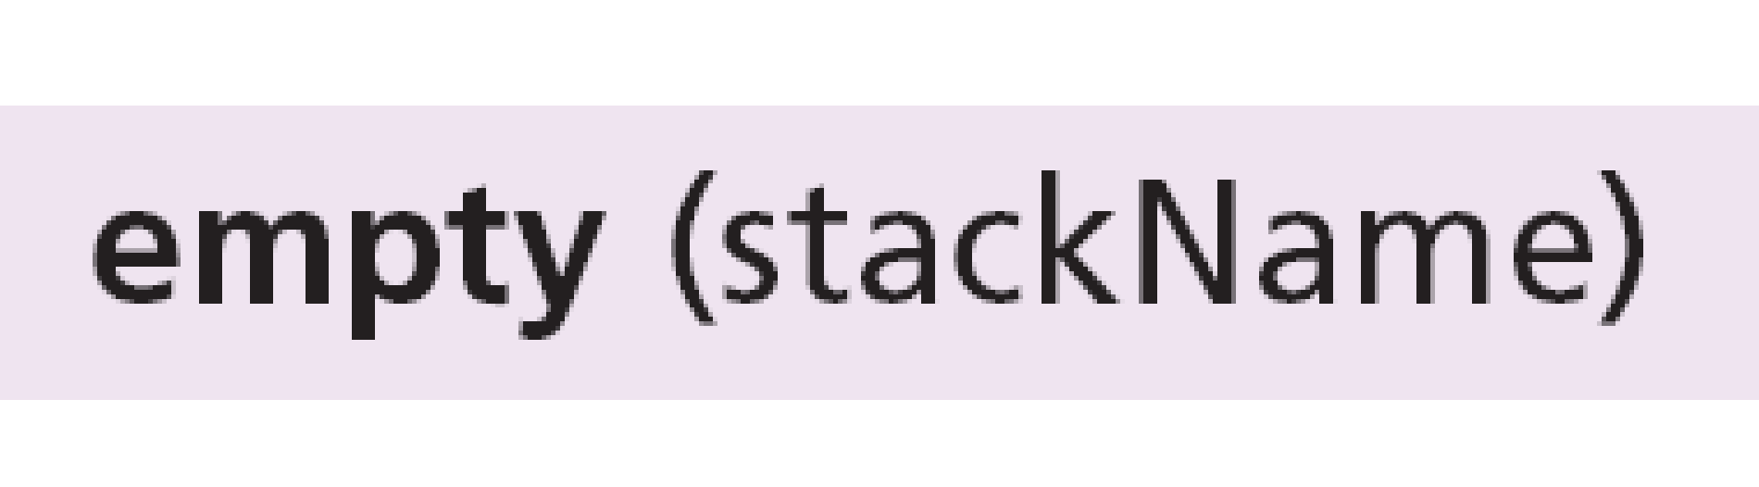
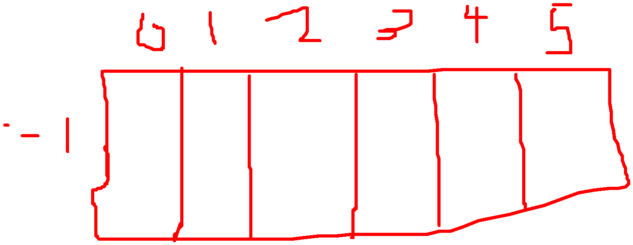
The empty operation
The empty operation checks the status of the stack. The following shows the format.
This operation returns true if the stack is empty and false if the stack is not empty.

Slide 9
Stack array implementation example
#include<stdio.h>
#include<conio.h>
#define MAXSIZE 10
void push();
int pop();
void traverse();
int stack[MAXSIZE];
int Top=-1;
void main()
{
int choice;
char ch;
do
{
printf("\n1. PUSH ");
printf("\n2. POP ");
printf("\n3. TRAVERSE ");
printf("\nEnter your choice: ");
scanf("%d",&choice);
switch(choice)
{
case 1: push();
break;
case 2: printf("\nThe deleted element is %d",pop());
break;
case 3: traverse();
break;
default: printf("\nYou Entered Wrong Choice");
}
printf("\nDo You Wish To Continue (Y/N)");
//fflush(stdin);
scanf("%s",&ch);
}
while(ch=='Y' || ch=='y');
}
void push()
{
int item;
if(Top == MAXSIZE - 1)
{
printf("\nThe Stack Is Full");
getch();
}
else
{
printf("Enter the element to be inserted: ");
scanf("%d",&item);
Top= Top+1;
stack[Top] = item;
}
}
void push()
{
int item;
if(Top == MAXSIZE - 1)
{
printf("\nThe Stack Is Full");
getch();
}
else
{
printf("Enter the element to be inserted: ");
scanf("%d",&item);
Top= Top+1;
stack[Top] = item;
}
}
int pop()
{
int item;
if(Top == -1)
{
printf("The stack is Empty");
getch();
}
else
{
item = stack[Top];
Top = Top-1;
}
return(item);
}
void traverse()
{
int i;
if(Top == -1)
{
printf("The Stack is Empty");
getch();
}
else
{
for(i=Top;i>=0;i--)
{
printf("\n%d",stack[i]);
}
}
}

Slide 10
Stack linked list implementation
#include <stdio.h>
#include <stdlib.h>
typedef struct node {
int data;
struct node *link;
} NODE;
void Push(int);
int pop();
void Display();
NODE *top = NULL; /* Global Declarations */
main() {
/* Main Program */
int opn, elem;
do {
printf("\n ### Linked List Implementation of STACK Operations ### \n\n");
printf("\n Press 1-Push, 2-Pop, 3-Display,4-Exit\n");
printf("\n Your option ? ");
scanf("%d", &opn);
switch (opn) {
case 1:
printf("\n\nRead the Element to be pushed ?");
scanf("%d", &elem);
Push(elem);
break;
case 2:
elem = Pop();
if (elem != -1)
printf(" Deleted Node(From Top)with the Data: %d\n", elem);
break;
case 3:
printf("Linked List Implementation of Stack: Status:\n");
Display();
break;
case 4:
printf("\n\n Terminating \n\n");
break;
default:
printf("\n\nInvalid Option !!! Try Again !! \n\n");
break;
}
printf("\n\n\n\n Press a Key to Continue . . . ");
getch();
} while (opn != 4);
}
void Push(int info) {
NODE *temp;
temp = (NODE *) malloc(sizeof(NODE));
if (temp == NULL)
printf(" Out of Memory !! Overflow !!!");
else {
temp->data = info;
temp->link = top;
top = temp;
printf(" Node has been inserted at Top(Front) Successfully !!");
}
}
int Pop() {
int info;
NODE *t;
if (top == NULL) {
printf(" Underflow!!!");
return -1;
} else {
t = top;
info = top->data;
top = top->link;
t->link = NULL;
free(t);
return (info);
}
}
void Display() {
NODE *t;
if (top == NULL)
printf("Empty Stack\n");
else {
t = top;
printf("Top->");
while (t) {
printf("[%d]->", t->data);
t = t->link;
}
printf("Null\n");
}
}

Slide 11
Stack applications
Stack applications can be classified into four broad categories: reversing data, pairing data and infix and postfix operations
Reversing data items
Reversing data items requires that a given set of data items be reordered so that the first and last items are exchanged, with all of the positions between the first and last also being relatively exchanged. For example, the list (2, 4, 7, 1, 6, 8) becomes (8, 6, 1, 7, 4, 2).
12.‹#›
Notes:
‹#›

Slide 12
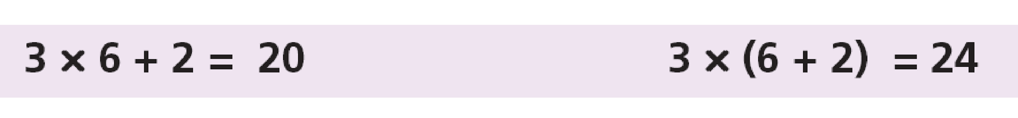
Pairing data items
We often need to pair some characters in an expression. For example, when we write a mathematical expression in a computer language, we often need to use parentheses to change the precedence of operators. The following two expressions are evaluated differently because of the parentheses in the second expression:
When we type an expression with a lot of parentheses, we often forget to pair the parentheses. One of the duties of a compiler is to do the checking for us. The compiler uses a stack to check that all opening parentheses are paired with a closing parentheses.
12.‹#›
Notes:
‹#›

Slide 13
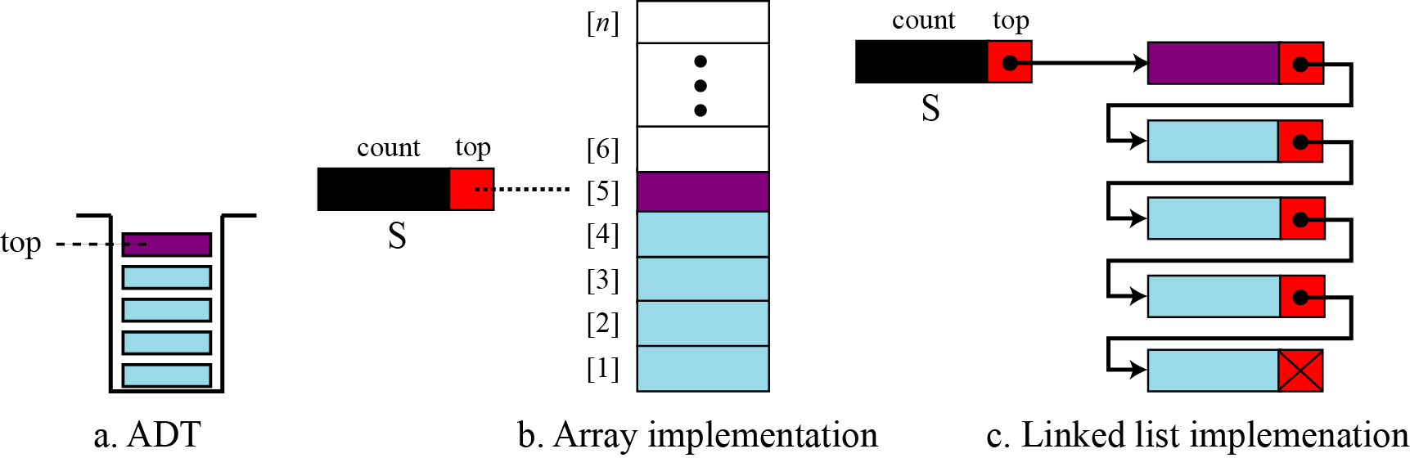
Figure 12.7 Stack implementations
12.‹#›
Notes:
‹#›

Slide 14
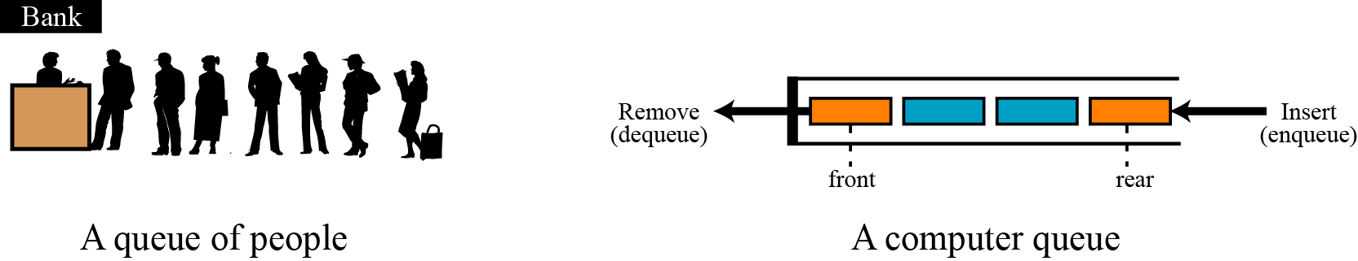
QUEUES
A queue is a linear list in which data can only be inserted at one end, called the rear, and deleted from the other end, called the front. These restrictions ensure that the data is processed through the queue in the order in which it is received. In other words, a queue is a first in, first out (FIFO) structure.
12.‹#›
Figure 12.8 Two representation of queues
Notes:
‹#›

Slide 15
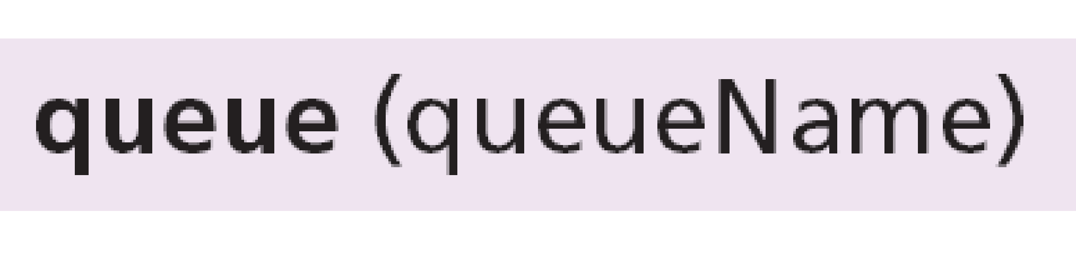
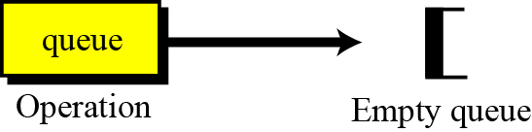
Operations on queues
Although we can define many operations for a queue, four are basic: queue, enqueue, dequeue and empty, as defined below.
The queue operation
The queue operation creates an empty queue. The following shows the format.
12.‹#›
Figure 12.9 The queue operation
Notes:
‹#›

Slide 16

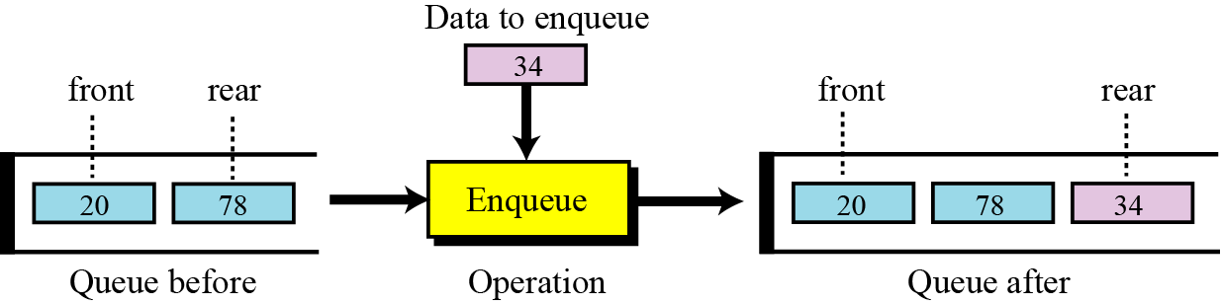
The enqueue operation
The enqueue operation inserts an item at the rear of the queue. The following shows the format.
12.‹#›
Figure 12.10 The enqueue operation
Notes:
‹#›

Slide 17
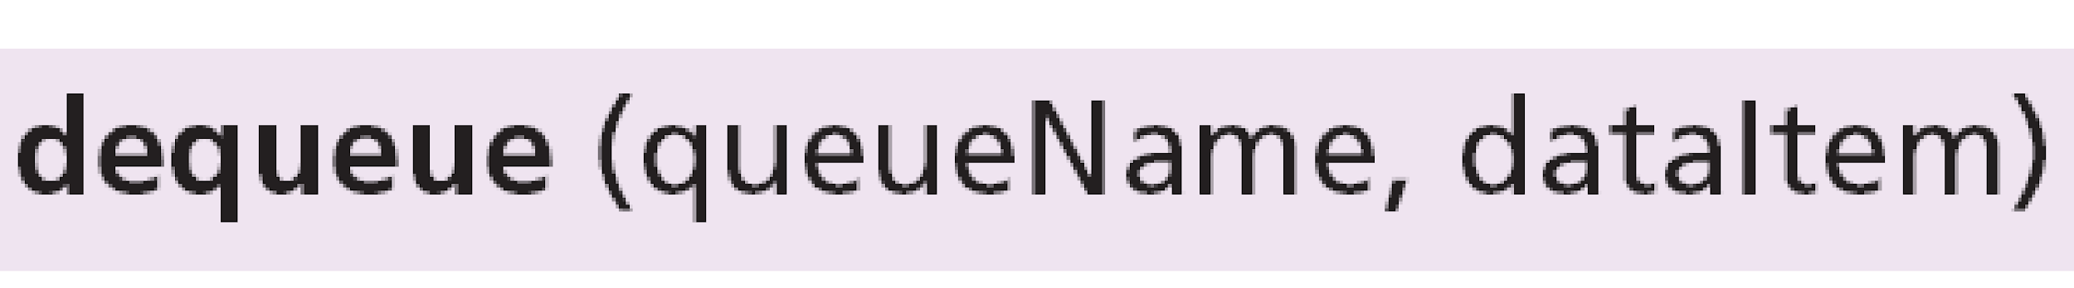
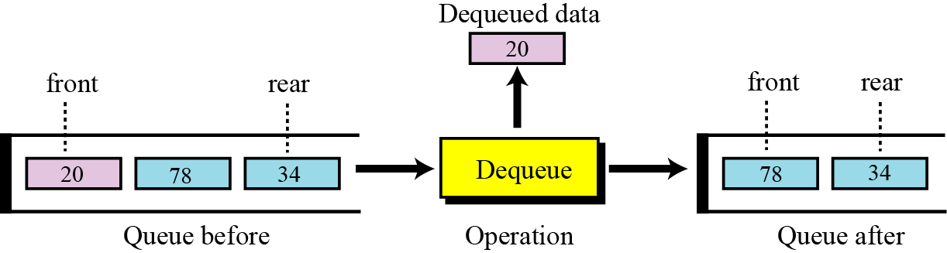
The dequeue operation
The dequeue operation deletes the item at the front of the queue. The following shows the format.
12.‹#›
Figure 12.11 The dequeue operation
Notes:
‹#›

Slide 18
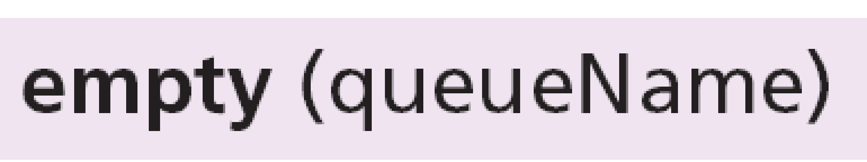
The empty operation
The empty operation checks the status of the queue. The following shows the format.
This operation returns true if the queue is empty and false if the queue is not empty.
12.‹#›
Notes:
‹#›

Slide 19
Queue applications
Queues are one of the most common of all data processing structures. They are found in virtually every operating system and network and in countless other areas. For example, queues are used in online business applications such as processing customer requests, jobs and orders. In a computer system, a queue is needed to process jobs and for system services such as print spools.
12.‹#›
Notes:
‹#›

Slide 20
Other Data Structures & Algorithms
Trees
Graphs
Heap
Sorting Algorithm
Bubblesort
Heapsort
Radix sort, etc.
Search Algorithm
Binary Search, etc.

Slide 21
Queue array implementation
#include <stdio.h>
#include <conio.h>
#include <malloc.h>
#include <process.h>
#include <ctype.h>
#include <stdlib.h>
#define SIZE 5
void menu();
void display();
int underflow();
int overflow();
void enqueue(int);
void dequeue();
int queue[SIZE];
int front=-1;
int rear=-1;
void main()
{
system("cls");
menu();
}
void menu()
{
int choice,item;
printf("MENU");
printf("\n1. Insert into the queue");
printf("\n2. Delete from queue");
printf("\n3. Display");
printf("\n4. Exit");
printf("\nEnter your choice: ");
scanf("%d",&choice);
switch(choice)
{
case 1:
//clrscr();
if(overflow()==0)
{
printf("\nEnter the item tobe inserted: ");
scanf("%d",&item);
enqueue(item);
//clrscr();
printf("\nAfter inserting queue is:\n");
}
display();
getch();
//clrscr();
menu();
break;
case 2:
//clrscr();
if(underflow()==1)
{
dequeue();
if(underflow()==1)
{
printf("\nAfter deletion queue is:\n");
display();
}
}
getch();
// clrscr();
menu();
break;
case 3:
// clrscr();
if(underflow()==1)
{
printf("The queue is:\n");
display();
}
getch();
//clrscr();
menu();
break;
case 4:
exit(1);
default:
//clrscr();
printf("Your choice is wrong\n\n");
menu();
}
}
int underflow()
{
if((front==-1)&&(rear==-1))
{
printf("\nQueue is empty");
return(0);
}
else
{
return(1);
}
}
int overflow()
{
if(rear==SIZE-1)
{
printf("\nQueue is full\n");
return(1);
}
else
{
return(0);
}
}
void enqueue(int item)
{
if((front==-1)&&(rear==-1))
{
front=0;
rear=0;
}
else
{
rear=rear+1;
}
queue[rear]=item;
}
void dequeue()
{
if(front==rear)
{
front=-1;
rear=-1;
}
else
{
front=front+1;
}
}
void display()
{
int i;
for(i=front;i<=rear;i++)
{
printf("\nElement %d : %d",i+1,queue[i]);
}
}

Slide 22
Queue linked list
case 6:
display();
break;
case 7:
queuesize();
break;
default:
printf("Wrong choice, Please enter correct choice ");
break;
}
}
}
/* Create an empty queue */
void create()
{
front = rear = NULL;
}
/* Returns queue size */
void queuesize()
{
printf("\n Queue size : %d", count);
}
/* Enqueing the queue */
void enq(int data)
{
if (rear == NULL)
{
rear = (struct node *)malloc(1*sizeof(struct node));
rear->ptr = NULL;
rear->info = data;
front = rear;
}
else
{
temp=(struct node *)malloc(1*sizeof(struct node));
rear->ptr = temp;
temp->info = data;
temp->ptr = NULL;
rear = temp;
}
count++;
}
/* Displaying the queue elements */
void display()
{
front1 = front;
if ((front1 == NULL) && (rear == NULL))
{
printf("Queue is empty");
return;
}
while (front1 != rear)
{
printf("%d ", front1->info);
front1 = front1->ptr;
}
if (front1 == rear)
printf("%d", front1->info);
}
/* Dequeing the queue */
void deq()
{
front1 = front;
if (front1 == NULL)
{
printf("\n Error: Trying to display elements from empty queue");
return;
}
else
if (front1->ptr != NULL)
{
front1 = front1->ptr;
printf("\n Dequed value : %d", front->info);
free(front);
front = front1;
}
else
{
printf("\n Dequed value : %d", front->info);
free(front);
front = NULL;
rear = NULL;
}
count--;
}
/* Returns the front element of queue */
int frontelement()
{
if ((front != NULL) && (rear != NULL))
return(front->info);
else
return 0;
}
/* Display if queue is empty or not */
void empty()
{
if ((front == NULL) && (rear == NULL))
printf("\n Queue empty");
else
printf("Queue not empty");
}
#include <stdio.h>
#include <stdlib.h>
struct node
{
int info;
struct node *ptr;
}*front,*rear,*temp,*front1;
int frontelement();
void enq(int data);
void deq();
void empty();
void display();
void create();
void queuesize();
int count = 0;
void main()
{
int no, ch, e;
printf("\n 1 - Enque");
printf("\n 2 - Deque");
printf("\n 3 - Front element");
printf("\n 4 - Empty");
printf("\n 5 - Exit");
printf("\n 6 - Display");
printf("\n 7 - Queue size");
create();
while (1)
{
printf("\n Enter choice : ");
scanf("%d", &ch);
switch (ch)
{
case 1:
printf("Enter data : ");
scanf("%d", &no);
enq(no);
break;
case 2:
deq();
break;
case 3:
e = frontelement();
if (e != 0)
printf("Front element : %d", e);
else
printf("\n No front element in Queue as queue is empty");
break;
case 4:
empty();
break;
case 5:
exit(0);

Slide 23
Assignment
Note: Put a comment with your name and yr. & section.
Create a stack in array and linked list implementation that will push 5 characters, display the characters, pop the two characters and display the remaining characters. Save as stackarray.c and stacklist.c
Create a queue in an array and linked list implementation that will enqueue 5 integers then dequeue 3 integers then display the remaining integers. Save as queuearray.c and queuelist.c

